Slide 1

Regression Analysis.

Slide 2
Schedule
Introduction
Regression
ANOVA
Residual fun

Slide 3
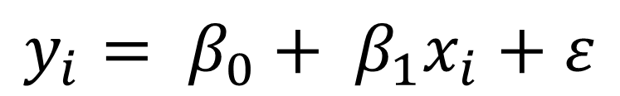
Modelling is quantifying relationships
$$y_{i}= β_{0}+ β_{1}x_{i}+ε$$
$$y_{i}= β_{0}+ β_{1}u_{i}+β_{2}v_{i}+β_{3}w_{i}+ε$$

Slide 4
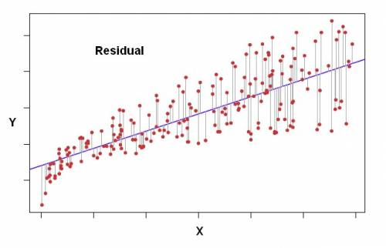

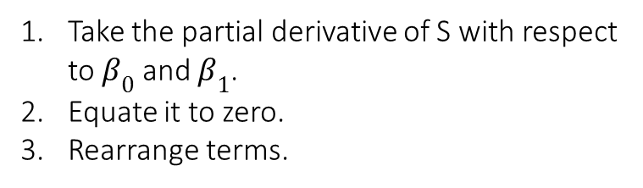

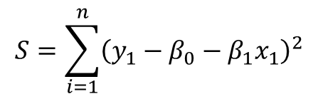



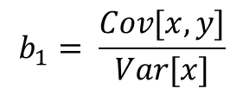

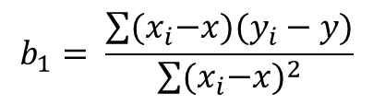
Estimating the parameters
$$e_{i}= y_{i}−\hat{y}$$
$$e_{i}= y_{i}−{(β}_{0}+β_{1}x_{i})$$
$$e_{i}= y_{i}−β_{0}−β_{1}x_{i}$$
$$e_{1}^{2}+e_{2}^{2}+…+e_{n}^{2}$$
Minimize the sum of vertical squared deviations from the line
$$S=\sum_{i=1}^{n}{{\left(y_{1}−β_{0}−β_{1}x_{1}\right)}^{2}}$$
Take the partial derivative of S with respect to $β_{0}$ and $β_{1}$.
Equate it to zero.
Rearrange terms.
$$b_{1}= \frac{\sum{{(x}_{i}−x)(y_{i}−y)}}{\sum{{{(x}_{i}−x)}^{2}}}$$
$$b_{0}=\overline{y}−b_{1}\overline{x}$$
$$b_{1}= \frac{Cov[x,y]}{Var[x]}$$
Note: Refer to linear regression theory primer for estimator properties and proofs

Slide 5
More Regression
Dustin:
Regression assumptions
Pulling in data
Doing a regression
ANOVA() output -> pass it on to Dharu

Slide 6
ANOVA
Analysis of Variance (ANOVA) consists of calculations that provide information about levels of variability within a regression model and form a basis for tests of significance.
DATA
FIT
RESIDUAL
$$\left(y_{i} − \overline{y}\right)=\left({\hat{y}}_{i} − \overline{y}\right)+(y_{i}− \hat{y})$$
Sum of Squares Total (SST) = Sum of Squares Model (SSM) + Sum of Squares Error (SSE)

Slide 7
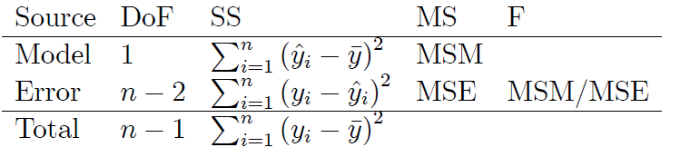
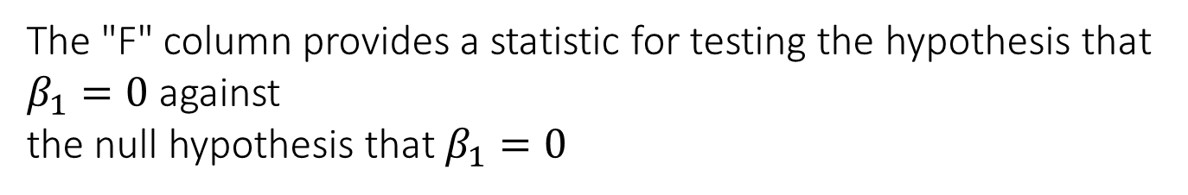
ANOVA: Simple Linear Model
r² = SSM/SST
The "F" column provides a statistic for testing the hypothesis that $β_{1}=0$against
the null hypothesis that $β_{1}=0$
When the MSM term is large relative to the MSE term, then the ratio is large and there is evidence against the null hypothesis.
For simple linear regression, the statistic MSM/MSE has an F distribution with degrees of freedom (DFM, DFE) = (1, n - 2).

Slide 8
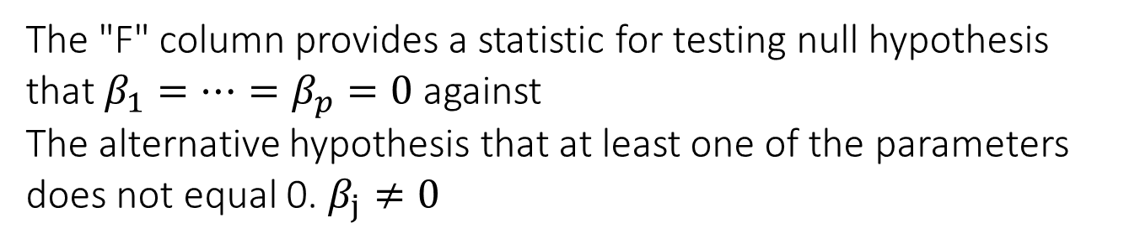
ANOVA: Multiple Linear Regression Model
p = # of explanatory variables
p
n-p -1
The "F" column provides a statistic for testing null hypothesis that $β_{1}=…=β_{p}=0$ against
The alternative hypothesis that at least one of the parameters does not equal 0. $β_{j}≠0$
The F test does not indicate which of the parameters is not equal to zero, only that at least one of them is linearly related to the response variable.

Slide 9
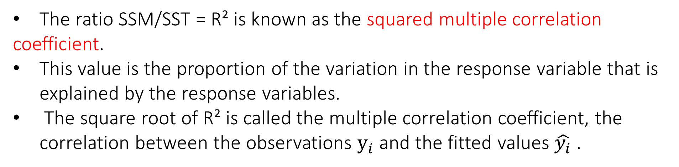
ANOVA: Multiple Linear Regression Model
R² = SSM/SST
The ratio SSM/SST = R² is known as the squared multiple correlation
coefficient.
This value is the proportion of the variation in the response variable that is explained by the response variables.
The square root of R² is called the multiple correlation coefficient, the correlation between the observations $y_{i}$and the fitted values $\hat{y_{i}}$.

Slide 10
Interpreting Residual Plots

